Slide 1
Chương 13: Hệ thống tập tin
NHẬP MÔN HỆ ĐIỀU HÀNH
502047

Slide 2
Ghi chú về bản quyền
Toàn bộ nội dung slide này tải về từ https://www.os-book.com/OS10/slide-dir/index.html , sinh viên có quyền tải về, lưu trữ, in ấn, tham khảo cho mục đích học tập. Sinh viên không được phát hành lại hay thay đổi nội dung slide nếu chưa có sự đồng ý của tác giả.
Phần ghi chú ở cuối slide (nếu có) là do các thầy cô ghi chú lại trong quá trình giảng dạy.

Slide 3
Outline
File Concept
Access Methods
Disk and Directory Structure
File-System Mounting
File Sharing
Protection

Slide 4
Objectives
To explain the function of file systems
To describe the interfaces to file systems
To discuss file-system design tradeoffs, including access methods, file sharing, file locking, and directory structures
To explore file-system protection

Slide 5
File Concept
Contiguous logical address space
Types:
Data
numeric
character
binary
Program
Contents defined by file’s creator
Many types
Consider text file, source file, executable file

Slide 6
File Attributes
Name – only information kept in human-readable form
Identifier – unique tag (number) identifies file within file system
Type – needed for systems that support different types
Location – pointer to file location on device
Size – current file size
Protection – controls who can do reading, writing, executing
Time, date, and user identification – data for protection, security, and usage monitoring
Information about files are kept in the directory structure, which is maintained on the disk
Many variations, including extended file attributes such as file checksum
Information kept in the directory structure

Slide 7
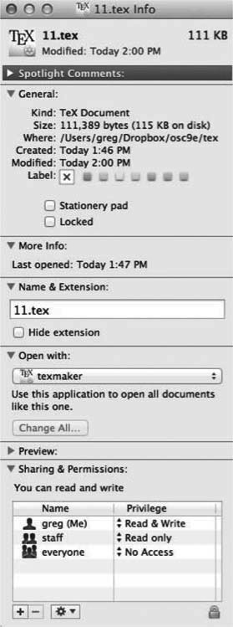
File info Window on Mac OS X

Slide 8
File Operations
File is an abstract data type
Create
Write – at write pointer location
Read – at read pointer location
Reposition within file - seek
Delete
Truncate
Open(F_{i}) – search the directory structure on disk for entry F_{i}, and move the content of entry to memory
Close (F_{i}) – move the content of entry F_{i} in memory to directory structure on disk

Slide 9
Open Files
Several pieces of data are needed to manage open files:
Open-file table: tracks open files
File pointer: pointer to last read/write location, per process that has the file open
File-open count: counter of number of times a file is open – to allow removal of data from open-file table when last processes closes it
Disk location of the file: cache of data access information
Access rights: per-process access mode information

Slide 10
Open File Locking
Provided by some operating systems and file systems
Similar to reader-writer locks
Shared lock similar to reader lock – several processes can acquire concurrently
Exclusive lock similar to writer lock
Mediates access to a file
Mandatory or advisory:
Mandatory – access is denied depending on locks held and requested
Advisory – processes can find status of locks and decide what to do

Slide 11
File Locking Example – Java API
import java.io.*;
import java.nio.channels.*;
public class LockingExample {
public static final boolean EXCLUSIVE = false;
public static final boolean SHARED = true;
public static void main(String arsg[]) throws IOException {
FileLock sharedLock = null;
FileLock exclusiveLock = null;
try {
RandomAccessFile raf = new RandomAccessFile("file.txt", "rw");
// get the channel for the file
FileChannel ch = raf.getChannel();
// this locks the first half of the file - exclusive
exclusiveLock = ch.lock(0, raf.length()/2, EXCLUSIVE);
/** Now modify the data . . . */
// release the lock
exclusiveLock.release();

Slide 12
File Locking Example – Java API (Cont.)
// this locks the second half of the file - shared
sharedLock = ch.lock(raf.length()/2+1, raf.length(), SHARED);
/** Now read the data . . . */
// release the lock
sharedLock.release();
} catch (java.io.IOException ioe) {
System.err.println(ioe);
}finally {
if (exclusiveLock != null)
exclusiveLock.release();
if (sharedLock != null)
sharedLock.release();
}
}
}

Slide 13
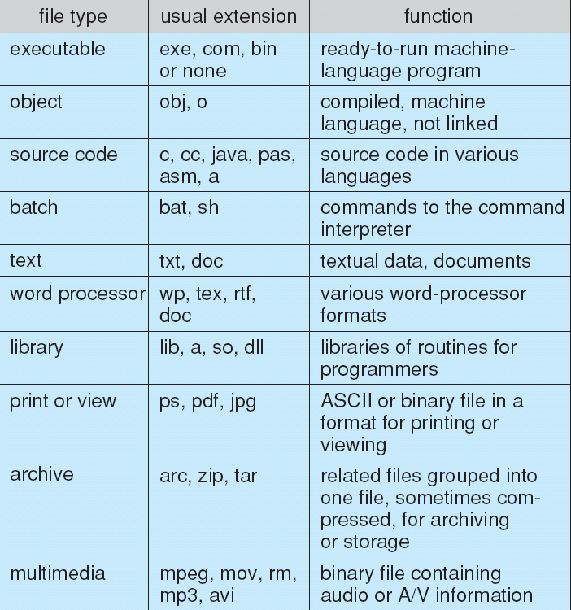
File Types – Name, Extension

Slide 14
File Structure
None - sequence of words, bytes
Simple record structure
Lines
Fixed length
Variable length
Complex Structures
Formatted document
Relocatable load file
Can simulate last two with first method by inserting appropriate control characters
Who decides:
Operating system
Program

Slide 15
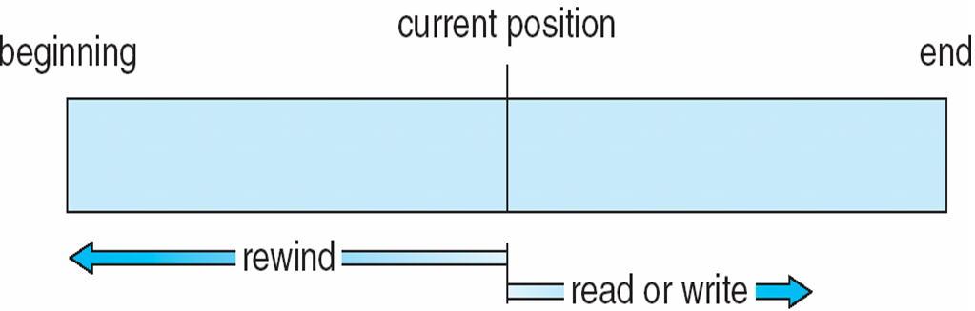
Sequential-access File

Slide 16
Access Methods
Sequential Access
read next
write next
reset
no read after last write
(rewrite)
Direct Access – file is fixed length logical records
read n
write n
position to n
read next
write next
rewrite n
n = relative block number
Relative block numbers allow OS to decide where file should be placed
See allocation problem in Ch 12

Slide 17
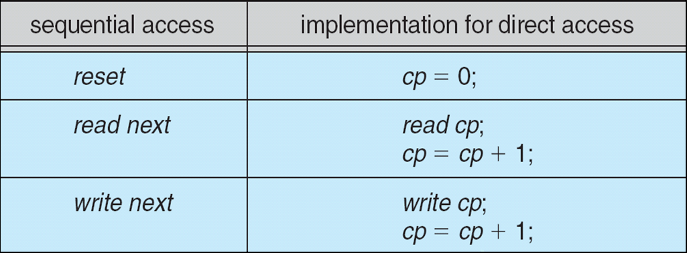
Simulation of Sequential Access on Direct-access File

Slide 18
Other Access Methods
Can be built on top of base methods
General involve creation of an index for the file
Keep index in memory for fast determination of location of data to be operated on (consider UPC code plus record of data about that item)
If too large, index (in memory) of the index (on disk)
IBM indexed sequential-access method (ISAM)
Small master index, points to disk blocks of secondary index
File kept sorted on a defined key
All done by the OS
VMS operating system provides index and relative files as another example (see next slide)

Slide 19
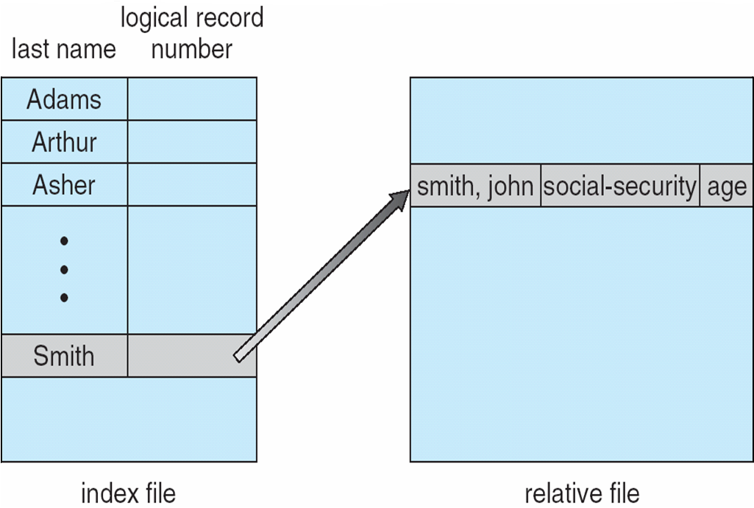
Example of Index and Relative Files

Slide 20
Directory Structure
A collection of nodes containing information about all files
Directory
Files
F 1
F 2
F 3
F 4
F n
Both the directory structure and the files reside on disk

Slide 21
Disk Structure
Disk can be subdivided into partitions
Disks or partitions can be RAID protected against failure
Disk or partition can be used raw – without a file system, or formatted with a file system
Partitions also known as minidisks, slices
Entity containing file system known as a volume
Each volume containing file system also tracks that file system’s info in device directory or volume table of contents
As well as general-purpose file systems there are many special-purpose file systems, frequently all within the same operating system or computer

Slide 22
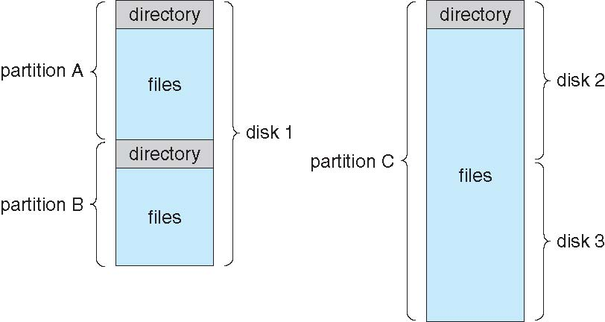
A Typical File-system Organization

Slide 23
Types of File Systems
We mostly talk of general-purpose file systems
But systems frequently have may file systems, some general- and some special- purpose
Consider Solaris has
tmpfs – memory-based volatile FS for fast, temporary I/O
objfs – interface into kernel memory to get kernel symbols for debugging
ctfs – contract file system for managing daemons
lofs – loopback file system allows one FS to be accessed in place of another
procfs – kernel interface to process structures
ufs, zfs – general purpose file systems

Slide 24
Operations Performed on Directory
Search for a file
Create a file
Delete a file
List a directory
Rename a file
Traverse the file system

Slide 25
Directory Organization
The directory is organized logically to obtain
Efficiency – locating a file quickly
Naming – convenient to users
Two users can have same name for different files
The same file can have several different names
Grouping – logical grouping of files by properties, (e.g., all Java programs, all games, …)

Slide 26
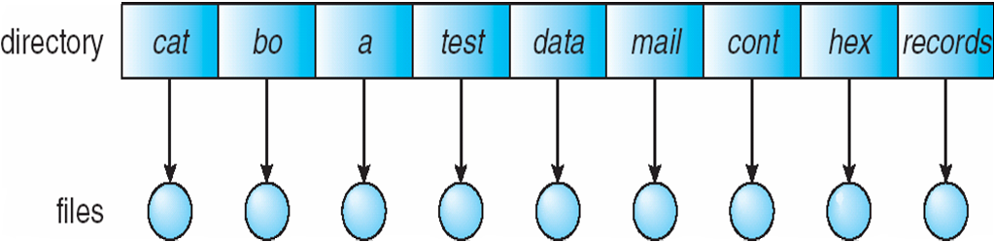
Single-Level Directory
A single directory for all users
Naming problem
Grouping problem

Slide 27
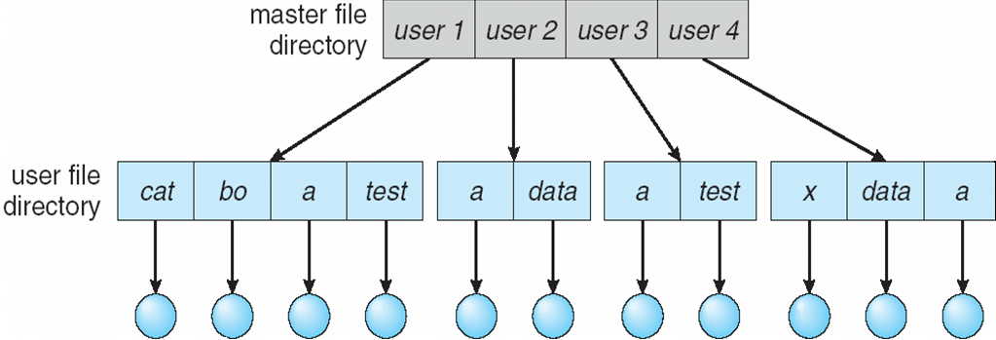
Two-Level Directory
Separate directory for each user
Path name
Can have the same file name for different user
Efficient searching
No grouping capability

Slide 28
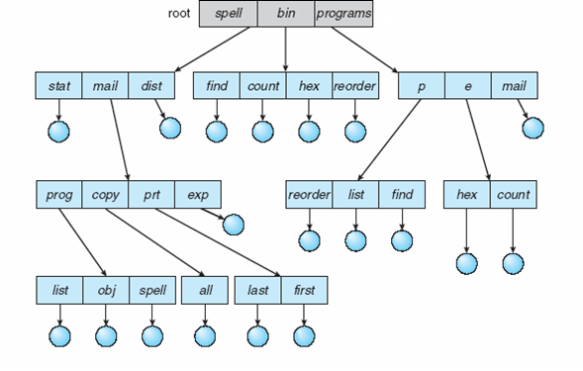
Tree-Structured Directories

Slide 29
Tree-Structured Directories (Cont.)
Efficient searching
Grouping Capability
Current directory (working directory)
cd /spell/mail/prog
type list

Slide 30
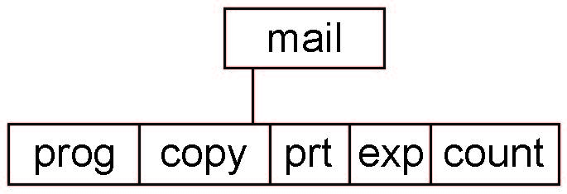
Tree-Structured Directories (Cont.)
Absolute or relative path name
Creating a new file is done in current directory
Delete a file
rm <file-name>
Creating a new subdirectory is done in current directory
mkdir <dir-name>
Example: if in current directory /mail
mkdir count
Deleting “mail” ⇒ deleting the entire subtree rooted by “mail”

Slide 31
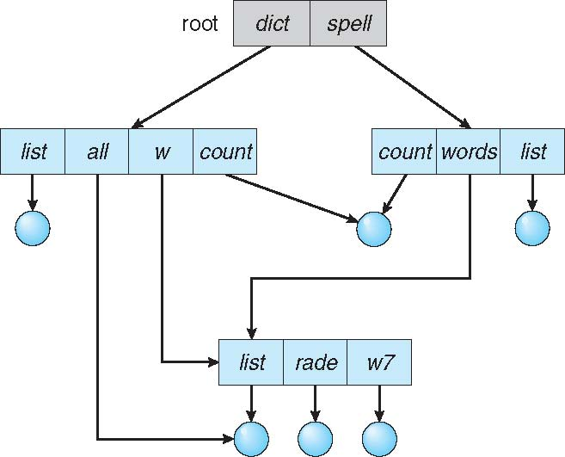
Acyclic-Graph Directories
Have shared subdirectories and files

Slide 32
Acyclic-Graph Directories (Cont.)
Two different names (aliasing)
If dict deletes list ⇒ dangling pointer
Solutions:
Backpointers, so we can delete all pointers Variable size records a problem
Backpointers using a daisy chain organization
Entry-hold-count solution
New directory entry type
Link – another name (pointer) to an existing file
Resolve the link – follow pointer to locate the file

Slide 33
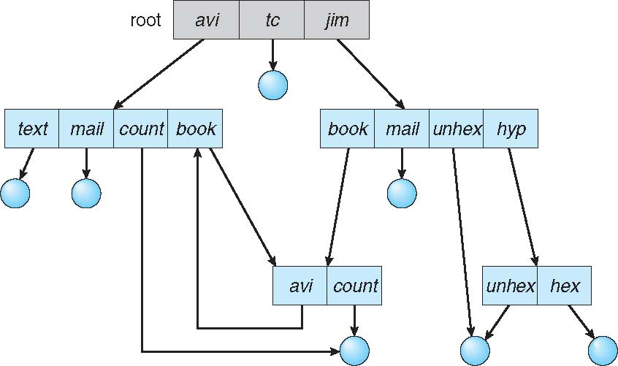
General Graph Directory

Slide 34
General Graph Directory (Cont.)
How do we guarantee no cycles?
Allow only links to file not subdirectories
Garbage collection
Every time a new link is added use a cycle detection algorithm to determine whether it is OK

Slide 35
File System Mounting
A file system must be mounted before it can be accessed
A unmounted file system (i.e., Fig. 11-11(b)) is mounted at a mount point

Slide 36
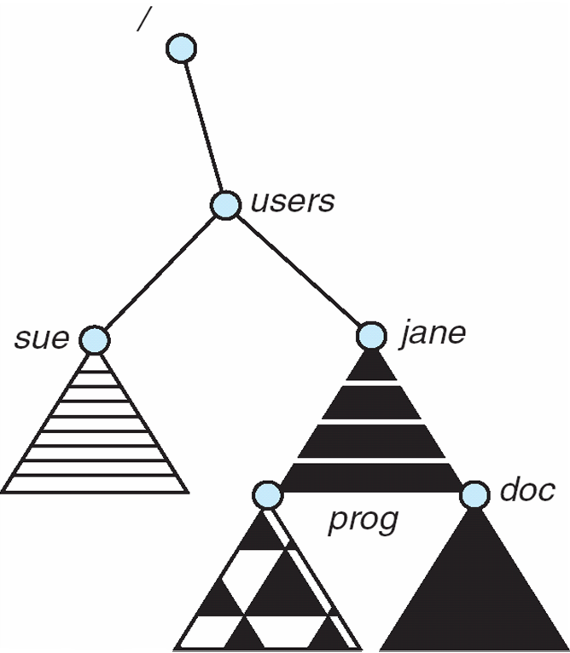
Mount Point

Slide 37
File Sharing
Sharing of files on multi-user systems is desirable
Sharing may be done through a protection scheme
On distributed systems, files may be shared across a network
Network File System (NFS) is a common distributed file-sharing method
If multi-user system
User IDs identify users, allowing permissions and protections to be per-user Group IDs allow users to be in groups, permitting group access rights
Owner of a file / directory
Group of a file / directory

Slide 38
File Sharing – Remote File Systems
Uses networking to allow file system access between systems
Manually via programs like FTP
Automatically, seamlessly using distributed file systems
Semi automatically via the world wide web
Client-server model allows clients to mount remote file systems from servers
Server can serve multiple clients
Client and user-on-client identification is insecure or complicated
NFS is standard UNIX client-server file sharing protocol
CIFS is standard Windows protocol
Standard operating system file calls are translated into remote calls
Distributed Information Systems (distributed naming services) such as LDAP, DNS, NIS, Active Directory implement unified access to information needed for remote computing

Slide 39
File Sharing – Failure Modes
All file systems have failure modes
For example corruption of directory structures or other non-user data, called metadata
Remote file systems add new failure modes, due to network failure, server failure
Recovery from failure can involve state information about status of each remote request
Stateless protocols such as NFS v3 include all information in each request, allowing easy recovery but less security

Slide 40
File Sharing – Consistency Semantics
Specify how multiple users are to access a shared file simultaneously
Similar to Ch 5 process synchronization algorithms
Tend to be less complex due to disk I/O and network latency (for remote file systems
Andrew File System (AFS) implemented complex remote file sharing semantics
Unix file system (UFS) implements:
Writes to an open file visible immediately to other users of the same open file
Sharing file pointer to allow multiple users to read and write concurrently
AFS has session semantics
Writes only visible to sessions starting after the file is closed

Slide 41
Protection
File owner/creator should be able to control:
what can be done
by whom
Types of access
Read
Write
Execute
Append
Delete
List

Slide 42
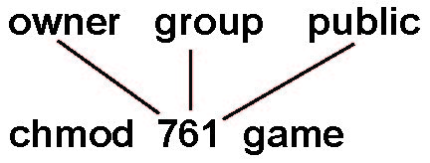
Access Lists and Groups
Mode of access: read, write, execute
Three classes of users on Unix / Linux
RWX
a) owner access 7 ⇒ 1 1 1 RWX
b) group access 6 ⇒ 1 1 0
RWX
c) public access 1 ⇒ 0 0 1
Ask manager to create a group (unique name), say G, and add some users to the group.
For a particular file (say game) or subdirectory, define an appropriate access.
Attach a group to a file chgrp G game

Slide 43
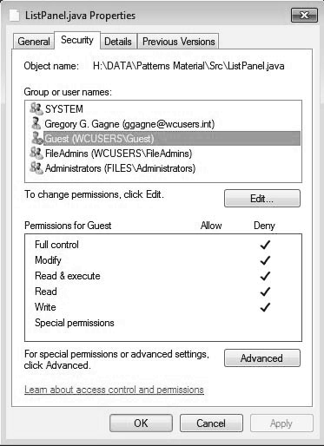
Windows 7 Access-Control List Management

Slide 44
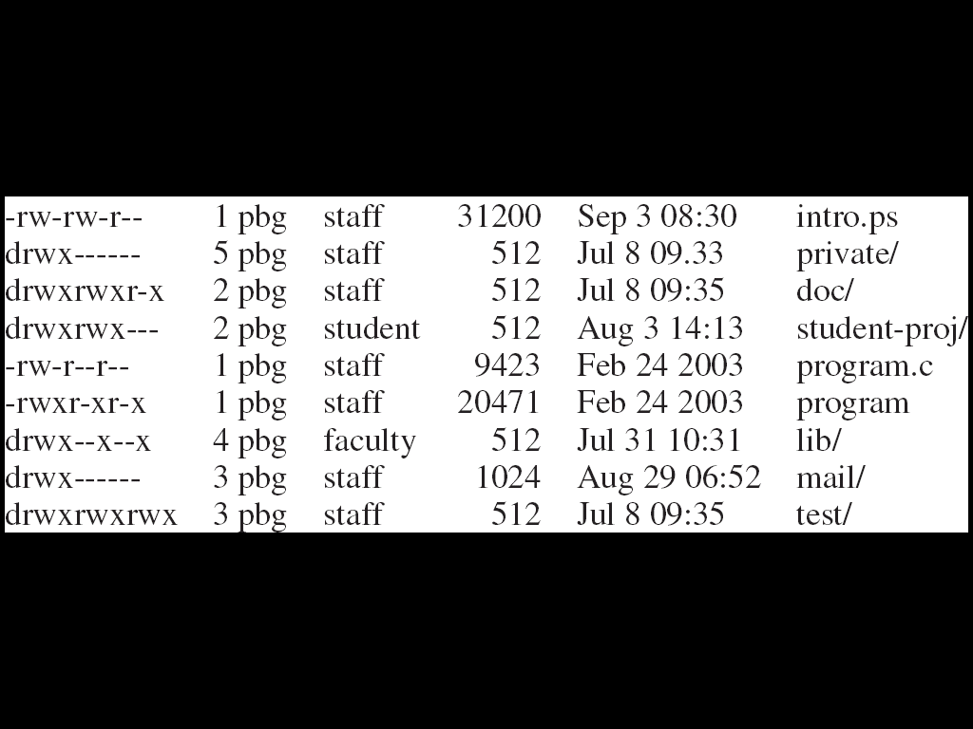
A Sample UNIX Directory Listing

Slide 45
End of Chapter 13

Slide 46
Chapter 14: File System Implementation

Slide 47
Outline
File-System Structure
File-System Operations
Directory Implementation
Allocation Methods
Free-Space Management
Efficiency and Performance
Recovery
Example: WAFL File System

Slide 48
Objectives
Describe the details of implementing local file systems and directory structures
Discuss block allocation and free-block algorithms and trade-offs
Explore file system efficiency and performance issues
Look at recovery from file system failures
Describe the WAFL file system as a concrete example

Slide 49
File-System Structure
File structure
Logical storage unit
Collection of related information
File system resides on secondary storage (disks)
Provided user interface to storage, mapping logical to physical
Provides efficient and convenient access to disk by allowing data to be stored, located retrieved easily
Disk provides in-place rewrite and random access
I/O transfers performed in blocks of sectors (usually 512 bytes)
File control block (FCB) – storage structure consisting of information about a file
Device driver controls the physical device
File system organized into layers

Slide 50
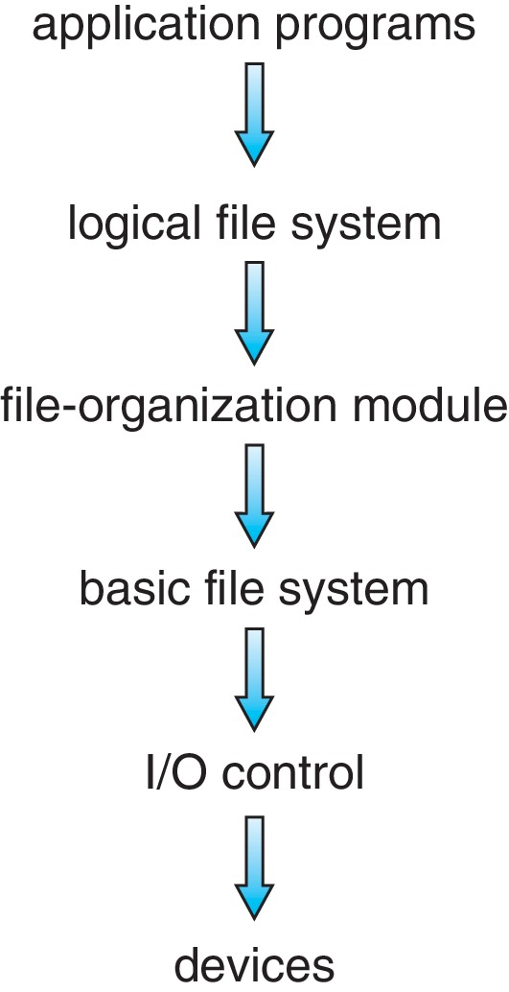
Layered File System

Slide 51
File System Layers
Device drivers manage I/O devices at the I/O control layer
Given commands like “read drive1, cylinder 72, track 2, sector 10, into memory location 1060” outputs low-level hardware specific commands to hardware controller
Basic file system given command like “retrieve block 123” translates to device driver
Also manages memory buffers and caches (allocation, freeing, replacement)
Buffers hold data in transit
Caches hold frequently used data
File organization module understands files, logical address, and physical blocks
Translates logical block # to physical block #
Manages free space, disk allocation

Slide 52
File System Layers (Cont.)
Logical file system manages metadata information
Translates file name into file number, file handle, location by maintaining file control blocks (inodes in UNIX)
Directory management
Protection
Layering useful for reducing complexity and redundancy, but adds overhead and can decrease performance
Logical layers can be implemented by any coding method according to OS designer

Slide 53
File System Layers (Cont.)
Many file systems, sometimes many within an operating system
Each with its own format (CD-ROM is ISO 9660; Unix has UFS, FFS; Windows has FAT, FAT32, NTFS as well as floppy, CD, DVD Blu-ray, Linux has more than 130 types, with extended file system ext3 and ext4 leading; plus distributed file systems, etc.)
New ones still arriving – ZFS, GoogleFS, Oracle ASM, FUSE

Slide 54
File-System Operations
We have system calls at the API level, but how do we implement their functions?
On-disk and in-memory structures
Boot control block contains info needed by system to boot OS from that volume
Needed if volume contains OS, usually first block of volume
Volume control block (superblock, master file table) contains volume details
Total # of blocks, # of free blocks, block size, free block pointers or array
Directory structure organizes the files
Names and inode numbers, master file table

Slide 55
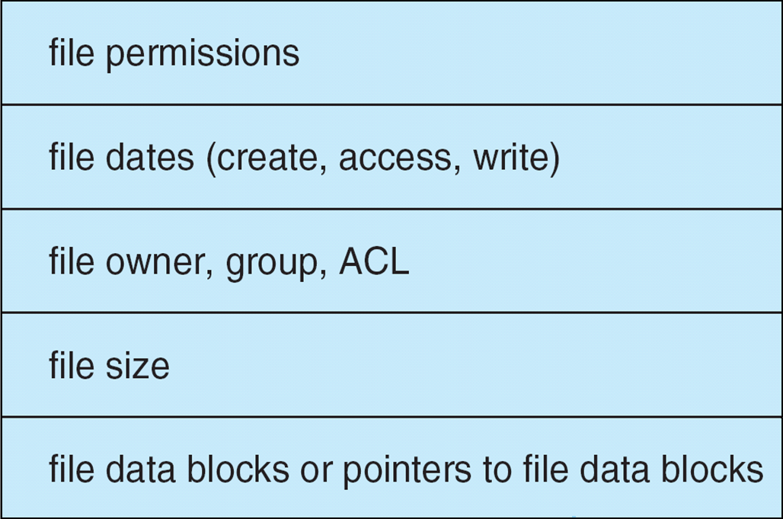
File-System Implementation (Cont.)
Per-file File Control Block (FCB) contains many details about the file
typically inode number, permissions, size, dates
NFTS stores into in master file table using relational DB structures

Slide 56
In-Memory File System Structures
Mount table storing file system mounts, mount points, file system types
system-wide open-file table contains a copy of the FCB of each file and other info
per-process open-file table contains pointers to appropriate entries in system-wide open-file table as well as other info
The following figure illustrates the necessary file system structures provided by the operating systems
Figure 12-3(a) refers to opening a file
Figure 12-3(b) refers to reading a file
Plus buffers hold data blocks from secondary storage
Open returns a file handle for subsequent use
Data from read eventually copied to specified user process memory address

Slide 57
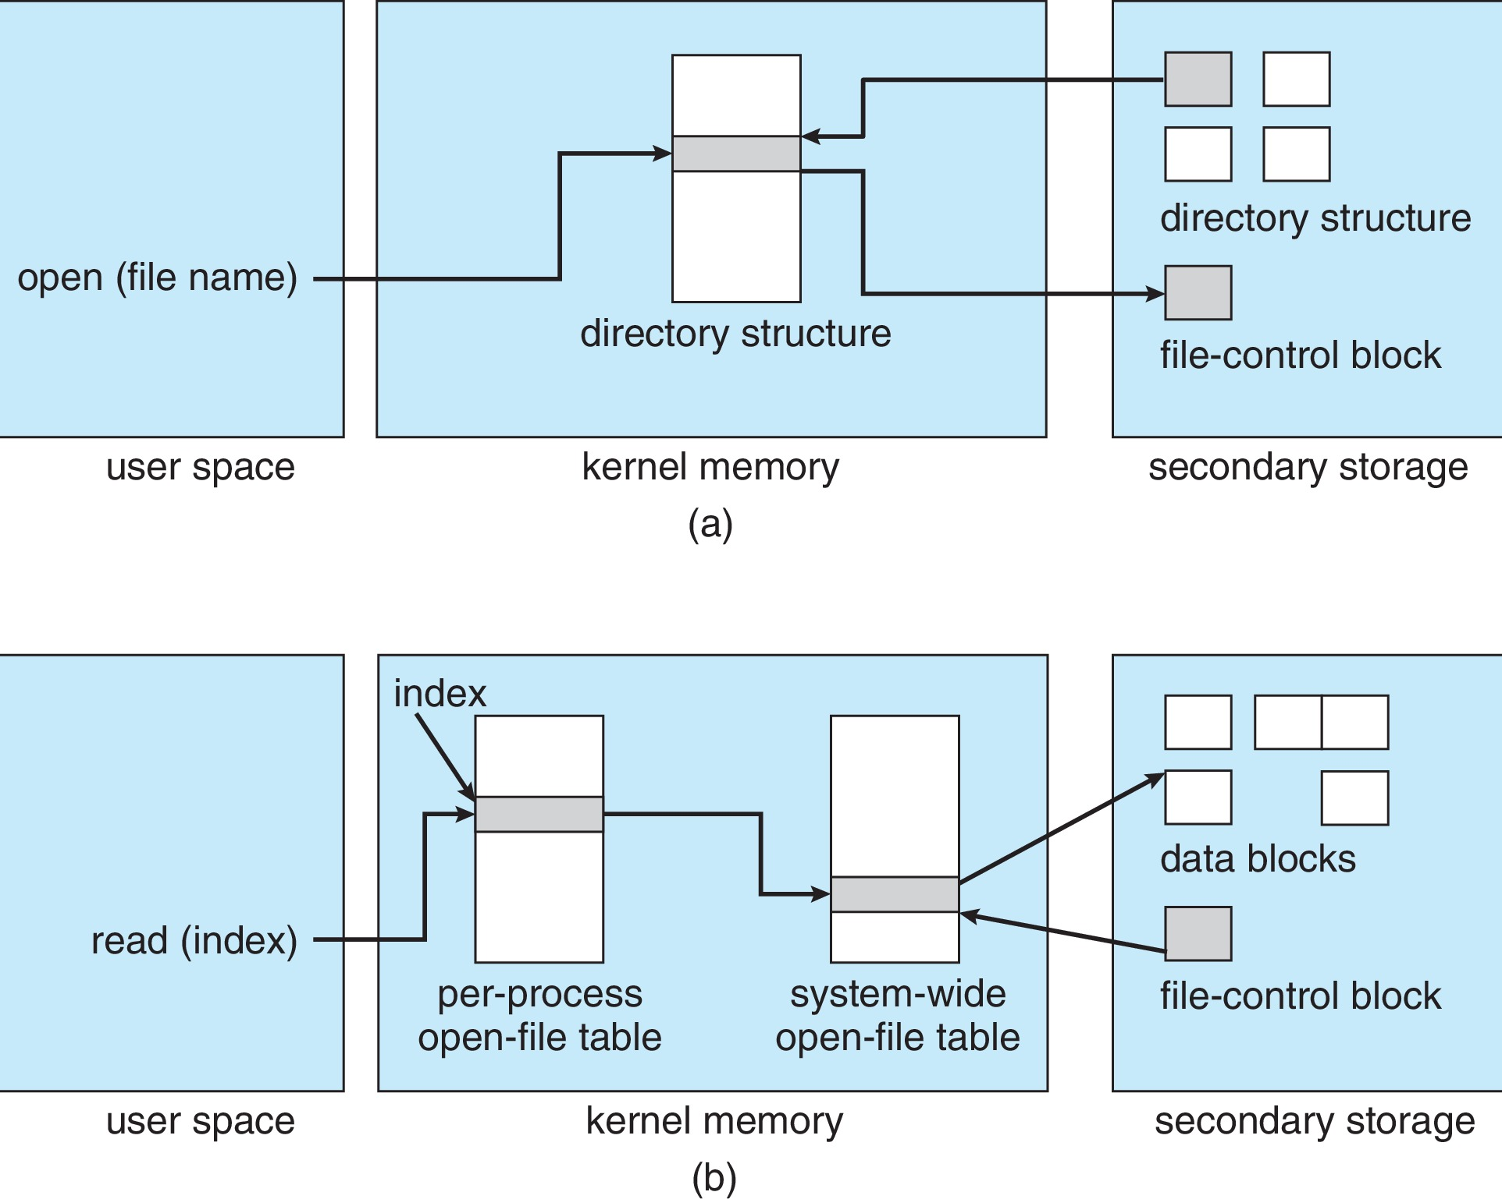
In-Memory File System Structures

Slide 58
Directory Implementation
Linear list of file names with pointer to the data blocks
Simple to program
Time-consuming to execute
Linear search time
Could keep ordered alphabetically via linked list or use B+ tree
Hash Table – linear list with hash data structure
Decreases directory search time
Collisions – situations where two file names hash to the same location
Only good if entries are fixed size, or use chained-overflow method

Slide 59
Allocation Methods - Contiguous
An allocation method refers to how disk blocks are allocated for files:
Contiguous allocation – each file occupies set of contiguous blocks
Best performance in most cases
Simple – only starting location (block #) and length (number of blocks) are required
Problems include finding space for file, knowing file size, external fragmentation, need for compaction off-line (downtime) or on-line

Slide 60
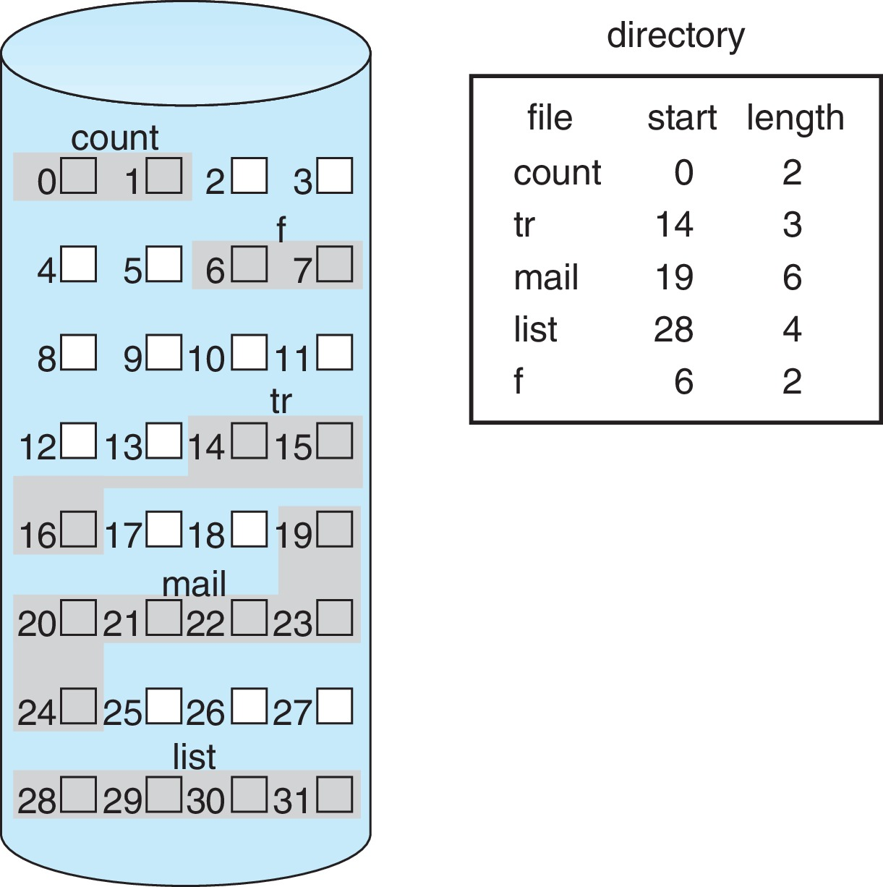
Contiguous Allocation
Mapping from logical to physical
Q
LA/512
R
Block to be accessed = Q + starting address
Displacement into block = R

Slide 61
Extent-Based Systems
Many newer file systems (i.e., Veritas File System) use a modified contiguous allocation scheme
Extent-based file systems allocate disk blocks in extents
An extent is a contiguous block of disks
Extents are allocated for file allocation
A file consists of one or more extents

Slide 62
Allocation Methods - Linked
Linked allocation – each file a linked list of blocks
File ends at nil pointer
No external fragmentation
Each block contains pointer to next block
No compaction, external fragmentation
Free space management system called when new block needed
Improve efficiency by clustering blocks into groups but increases internal fragmentation
Reliability can be a problem
Locating a block can take many I/Os and disk seeks

Slide 63
Allocation Methods – Linked (Cont.)
FAT (File Allocation Table) variation
Beginning of volume has table, indexed by block number
Much like a linked list, but faster on disk and cacheable
New block allocation simple

Slide 64
Linked Allocation
Each file is a linked list of disk blocks: blocks may be scattered anywhere on the disk
block =
pointer
Mapping
Q
LA/511
R
Block to be accessed is the Qth block in the linked chain of blocks representing the file.
Displacement into block = R + 1

Slide 65
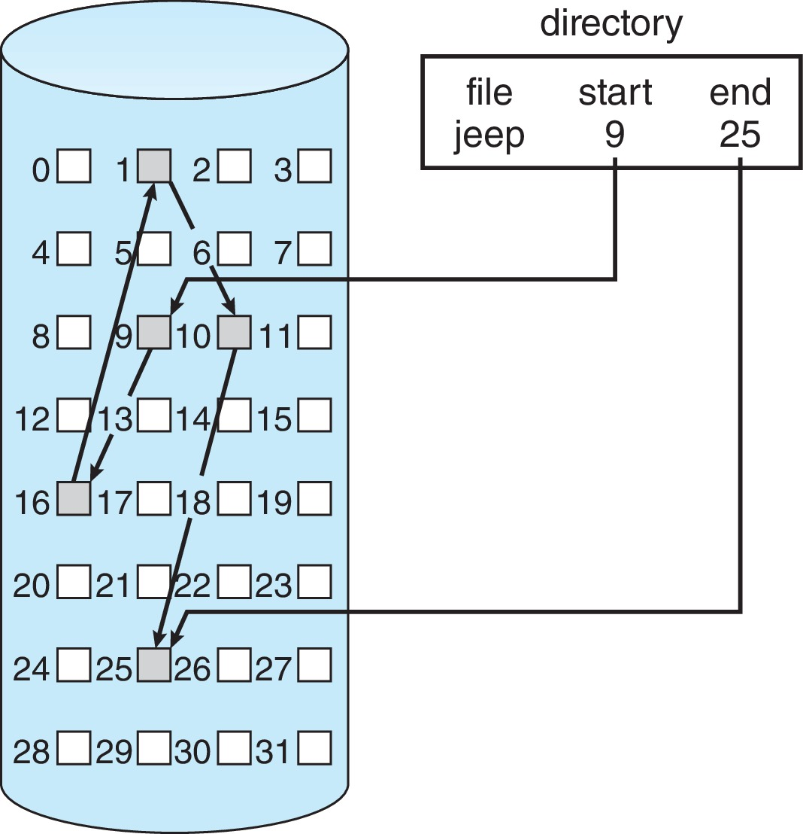
Linked Allocation

Slide 66
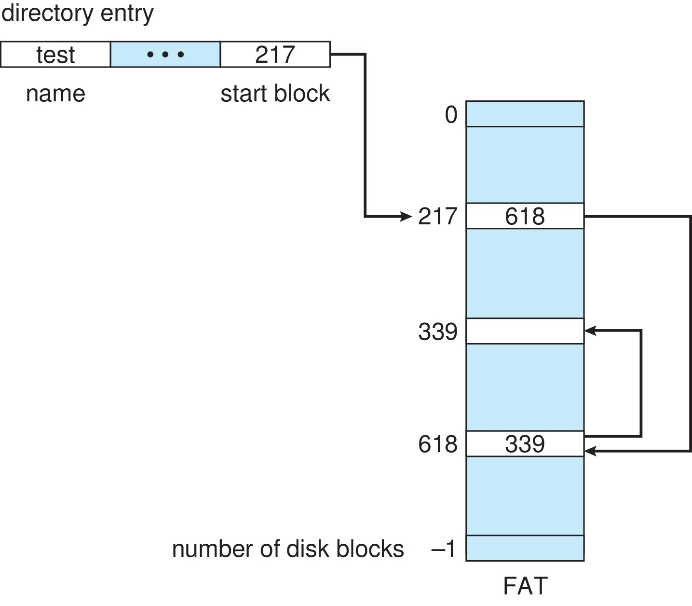
File-Allocation Table

Slide 67
Allocation Methods - Indexed
Indexed allocation
Each file has its own index block(s) of pointers to its data blocks
Logical view

Slide 68
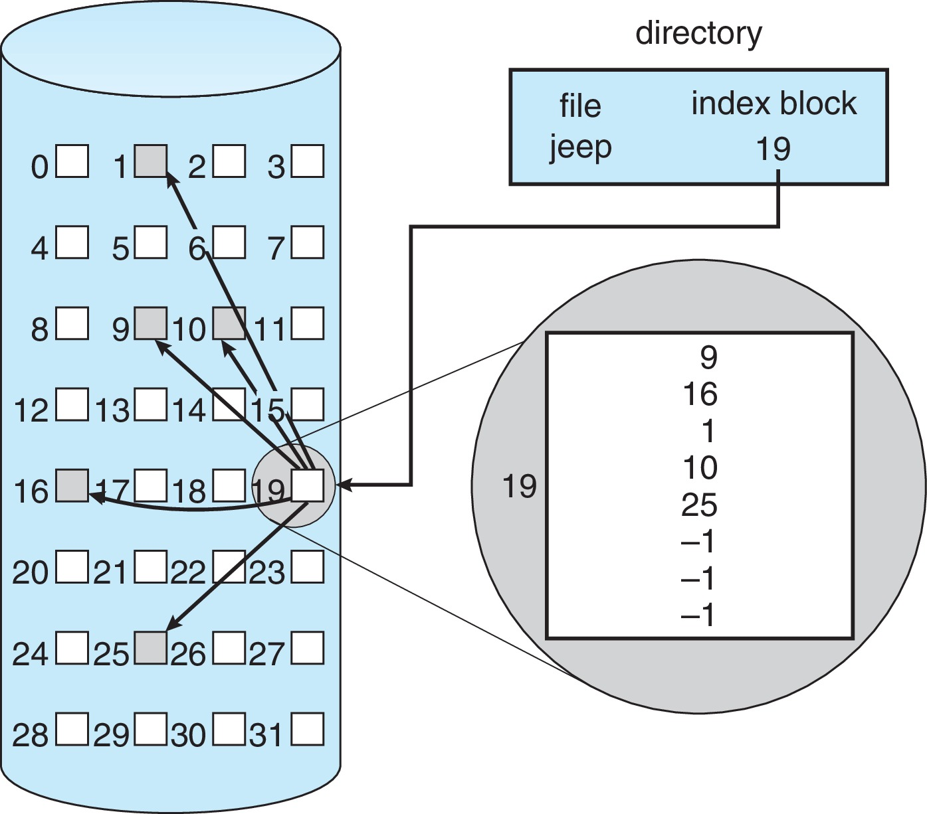
Example of Indexed Allocation

Slide 69
Indexed Allocation (Cont.)
Need index table
Random access
Dynamic access without external fragmentation, but have overhead of index block
Mapping from logical to physical in a file of maximum size of 256K bytes and block size of 512 bytes. We need only 1 block for index table
Q
LA/512
R
Q = displacement into index table
R = displacement into block

Slide 70
Indexed Allocation – Mapping (Cont.)
Mapping from logical to physical in a file of unbounded length (block size of 512 words)
Linked scheme – Link blocks of index table (no limit on size)
Q₁
LA / (512 x 511)
R₁
Q₁ = block of index table
R₁ is used as follows:
Q₂
R₁ / 512
R₂
Q₂ = displacement into block of index table
R₂ displacement into block of file:

Slide 71
Indexed Allocation – Mapping (Cont.)
Two-level index (4K blocks could store 1,024 four-byte pointers in outer index -> 1,048,567 data blocks and file size of up to 4GB)
Q₁
LA / (512 x 512)
R₁
Q₁ = displacement into outer-index
R₁ is used as follows:
Q₂
R₁ / 512
R₂
Q₂ = displacement into block of index table
R₂ displacement into block of file:

Slide 72
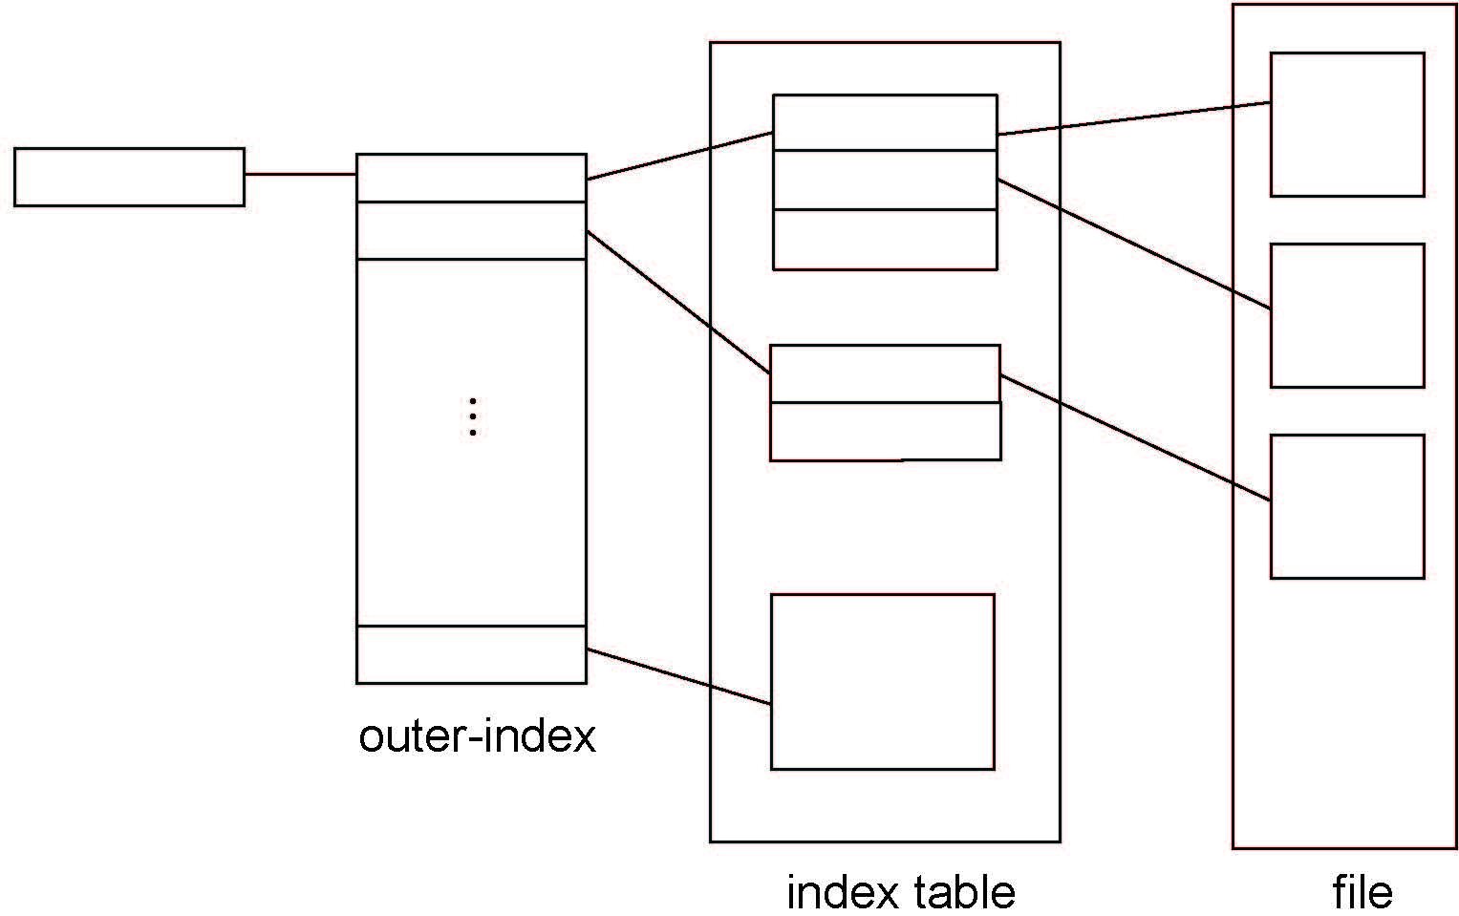
Indexed Allocation – Mapping (Cont.)

Slide 73
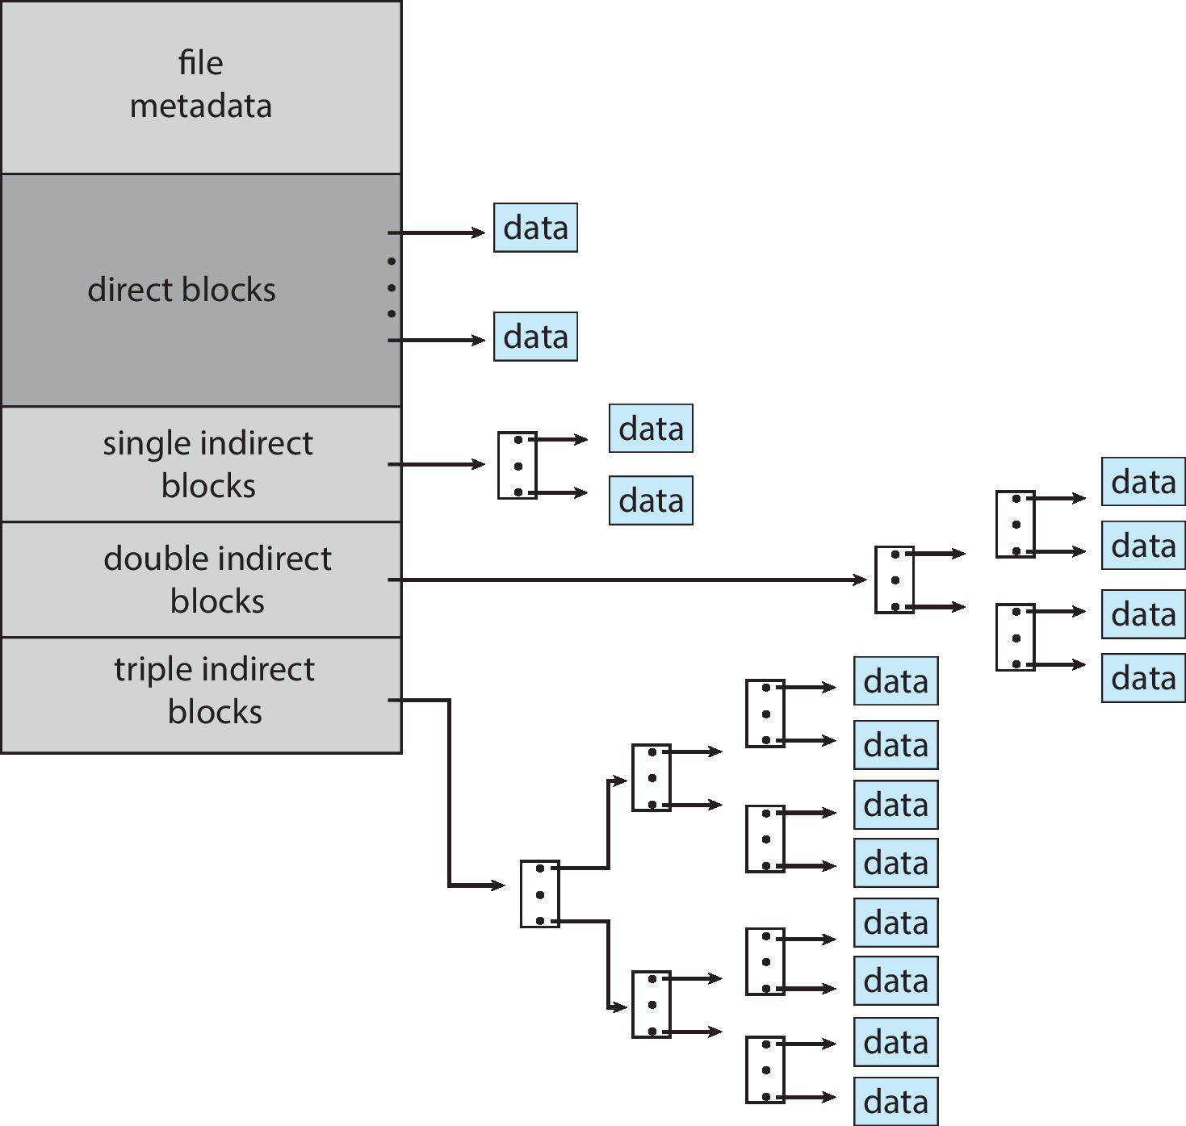
Combined Scheme: UNIX UFS
4K bytes per block, 32-bit addresses
More index blocks than can be addressed with 32-bit file pointer

Slide 74
Performance
Best method depends on file access type
Contiguous great for sequential and random
Linked good for sequential, not random
Declare access type at creation -> select either contiguous or linked
Indexed more complex
Single block access could require 2 index block reads then data block read
Clustering can help improve throughput, reduce CPU overhead
For NVM, no disk head so different algorithms and optimizations needed
Using old algorithm uses many CPU cycles trying to avoid non-existent head movement
With NVM goal is to reduce CPU cycles and overall path needed for I/O

Slide 75
Performance (Cont.)
Adding instructions to the execution path to save one disk I/O is reasonable
Intel Core i7 Extreme Edition 990x (2011) at 3.46Ghz = 159,000 MIPS
http://en.wikipedia.org/wiki/Instructions_per_second
Typical disk drive at 250 I/Os per second
159,000 MIPS / 250 = 630 million instructions during one disk I/O
Fast SSD drives provide 60,000 IOPS
159,000 MIPS / 60,000 = 2.65 millions instructions during one disk I/O

Slide 76
Free-Space Management
File system maintains free-space list to track available blocks/clusters
(Using term “block” for simplicity)
Bit vector or bit map (n blocks)
0
1
2
n-1
…
1 ⇒ block[i] free
0 ⇒ block[i] occupied
bit[i] =

Block number calculation
(number of bits per word) *
(number of 0-value words) +
offset of first 1 bit
CPUs have instructions to return offset within word of first “1” bit

Slide 77
Free-Space Management (Cont.)
Bit map requires extra space
Example:
block size = 4KB = 2¹² bytes
disk size = 2⁴⁰ bytes (1 terabyte)
n = 2⁴⁰/2¹² = 2²⁸ bits (or 32MB)
if clusters of 4 blocks -> 8MB of memory
Easy to get contiguous files

Slide 78
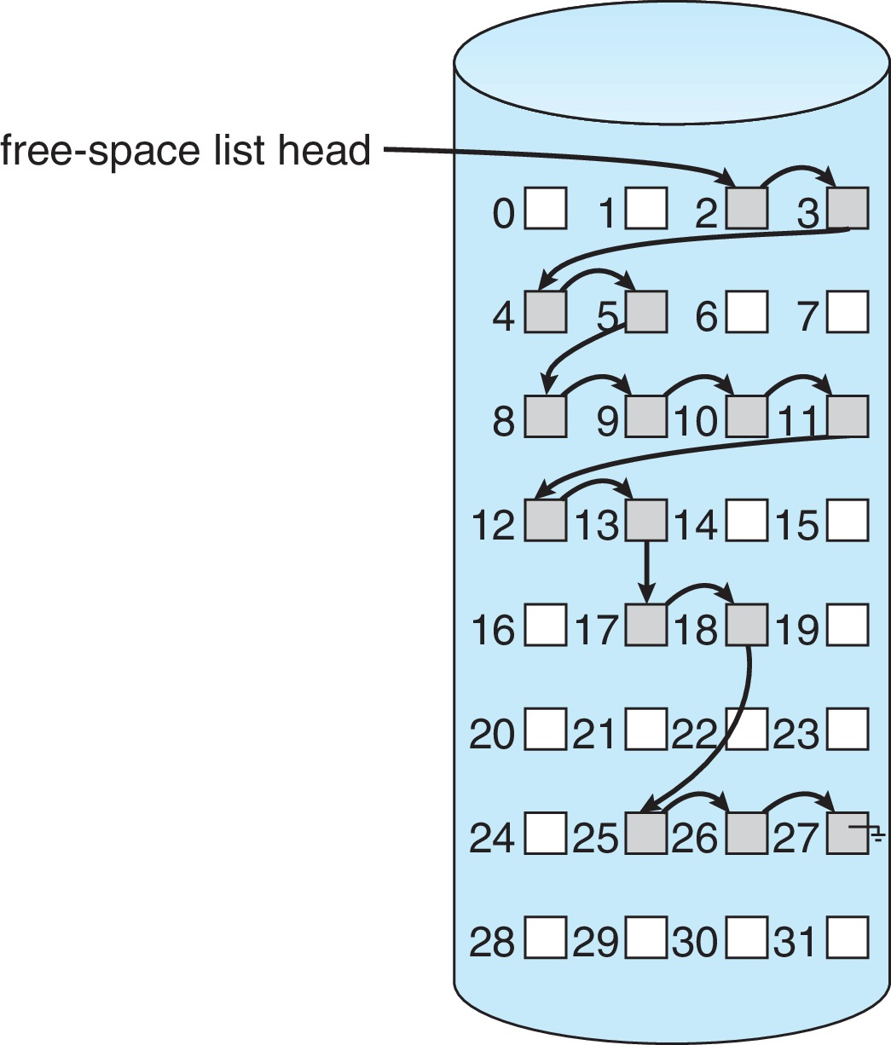
Linked Free Space List on Disk
Linked list (free list)
Cannot get contiguous space easily
No waste of space
No need to traverse the entire list (if # free blocks recorded)

Slide 79
Free-Space Management (Cont.)
Grouping
Modify linked list to store address of next n-1 free blocks in first free block, plus a pointer to next block that contains free-block-pointers (like this one)
Counting
Because space is frequently contiguously used and freed, with contiguous-allocation allocation, extents, or clustering
Keep address of first free block and count of following free blocks
Free space list then has entries containing addresses and counts

Slide 80
Free-Space Management (Cont.)
Space Maps
Used in ZFS
Consider meta-data I/O on very large file systems
Full data structures like bit maps couldn’t fit in memory -> thousands of I/Os
Divides device space into metaslab units and manages metaslabs
Given volume can contain hundreds of metaslabs
Each metaslab has associated space map
Uses counting algorithm
But records to log file rather than file system
Log of all block activity, in time order, in counting format
Metaslab activity -> load space map into memory in balanced-tree structure, indexed by offset
Replay log into that structure
Combine contiguous free blocks into single entry

Slide 81
TRIMing Unused Blocks
HDDS overwrite in place so need only free list
Blocks not treated specially when freed
Keeps its data but without any file pointers to it, until overwritten
Storage devices not allowing overwrite (like NVM) suffer badly with same algorithm
Must be erased before written, erases made in large chunks (blocks, composed of pages) and are slow
TRIM is a newer mechanism for the file system to inform the NVM storage device that a page is free
Can be garbage collected or if block is free, now block can be erased

Slide 82
Efficiency and Performance
Efficiency dependent on:
Disk allocation and directory algorithms
Types of data kept in file’s directory entry
Pre-allocation or as-needed allocation of metadata structures
Fixed-size or varying-size data structures

Slide 83
Efficiency and Performance (Cont.)
Performance
Keeping data and metadata close together
Buffer cache – separate section of main memory for frequently used blocks
Synchronous writes sometimes requested by apps or needed by OS
No buffering / caching – writes must hit disk before acknowledgement
Asynchronous writes more common, buffer-able, faster
Free-behind and read-ahead – techniques to optimize sequential access
Reads frequently slower than writes

Slide 84
Page Cache
A page cache caches pages rather than disk blocks using virtual memory techniques and addresses
Memory-mapped I/O uses a page cache
Routine I/O through the file system uses the buffer (disk) cache
This leads to the following figure

Slide 85
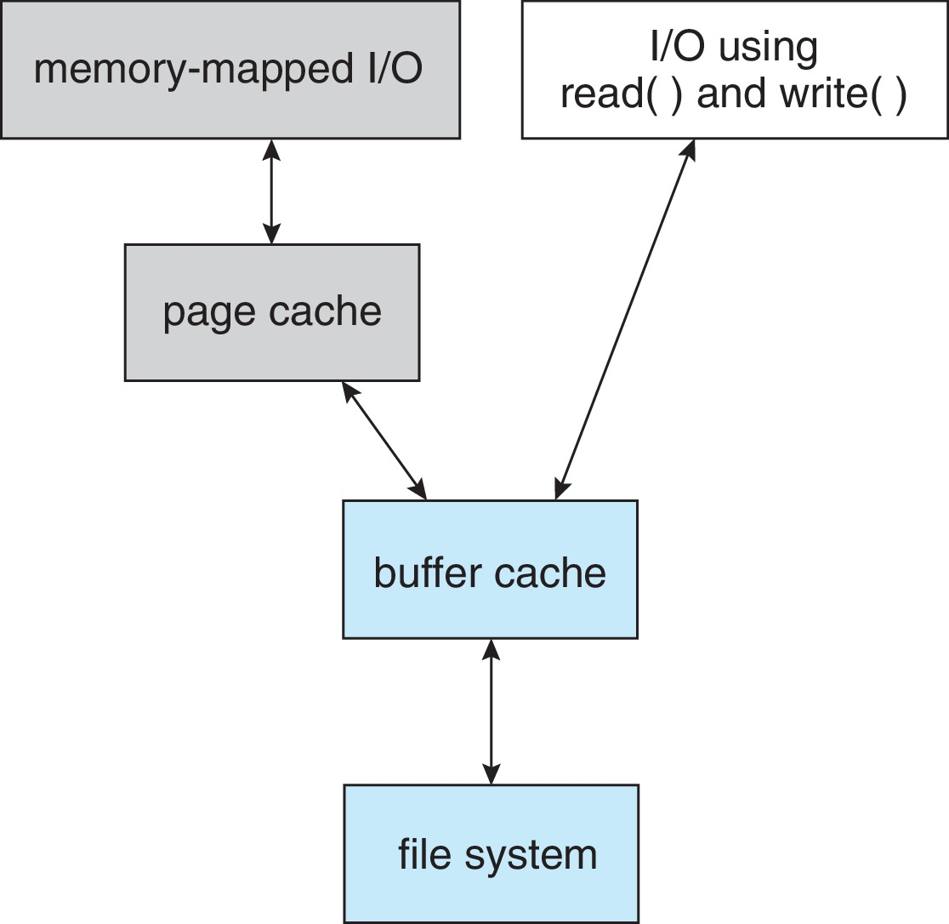
I/O Without a Unified Buffer Cache

Slide 86
Unified Buffer Cache
A unified buffer cache uses the same page cache to cache both memory-mapped pages and ordinary file system I/O to avoid double caching
But which caches get priority, and what replacement algorithms to use?

Slide 87
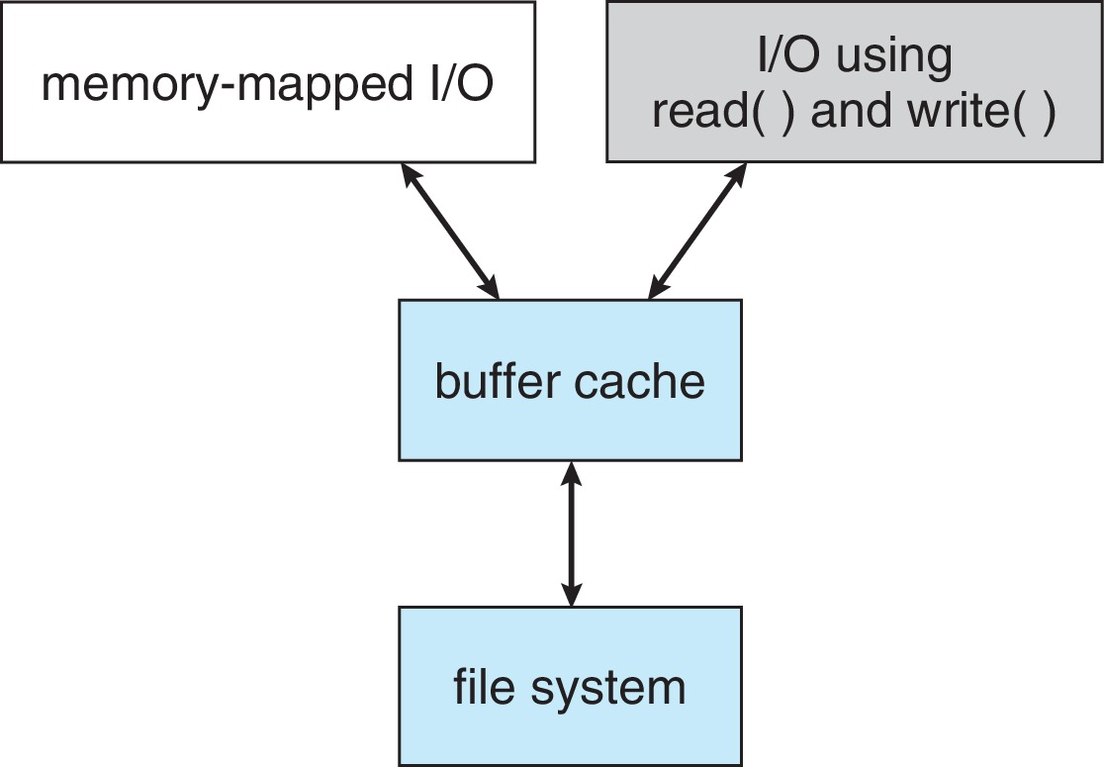
I/O Using a Unified Buffer Cache

Slide 88
Recovery
Consistency checking – compares data in directory structure with data blocks on disk, and tries to fix inconsistencies
Can be slow and sometimes fails
Use system programs to back up data from disk to another storage device (magnetic tape, other magnetic disk, optical)
Recover lost file or disk by restoring data from backup

Slide 89
Log Structured File Systems
Log structured (or journaling) file systems record each metadata update to the file system as a transaction
All transactions are written to a log
A transaction is considered committed once it is written to the log (sequentially)
Sometimes to a separate device or section of disk
However, the file system may not yet be updated
The transactions in the log are asynchronously written to the file system structures
When the file system structures are modified, the transaction is removed from the log
If the file system crashes, all remaining transactions in the log must still be performed
Faster recovery from crash, removes chance of inconsistency of metadata

Slide 90
Example: WAFL File System
Used on Network Appliance “Filers” – distributed file system appliances
“Write-anywhere file layout”
Serves up NFS, CIFS, http, ftp
Random I/O optimized, write optimized
NVRAM for write caching
Similar to Berkeley Fast File System, with extensive modifications

Slide 91
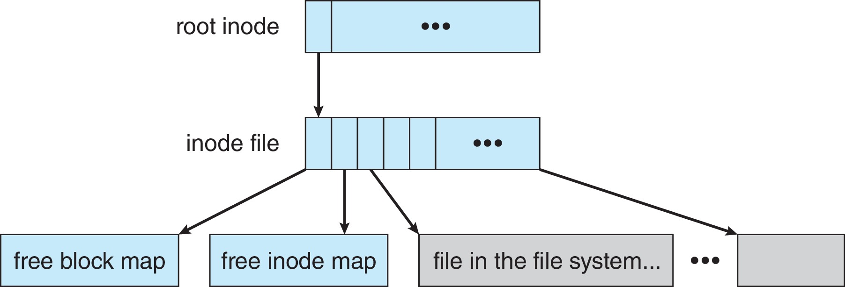
The WAFL File Layout

Slide 92
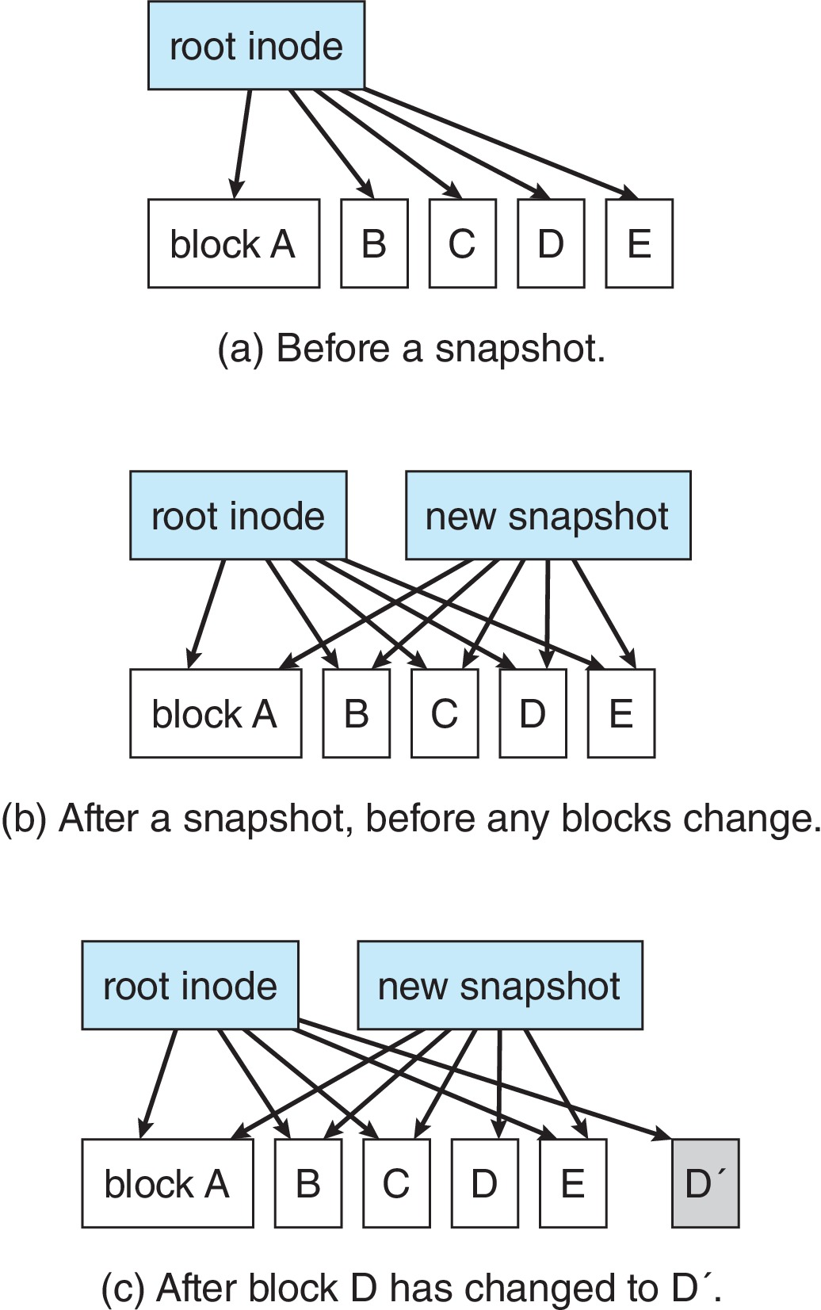
Snapshots in WAFL

Slide 93
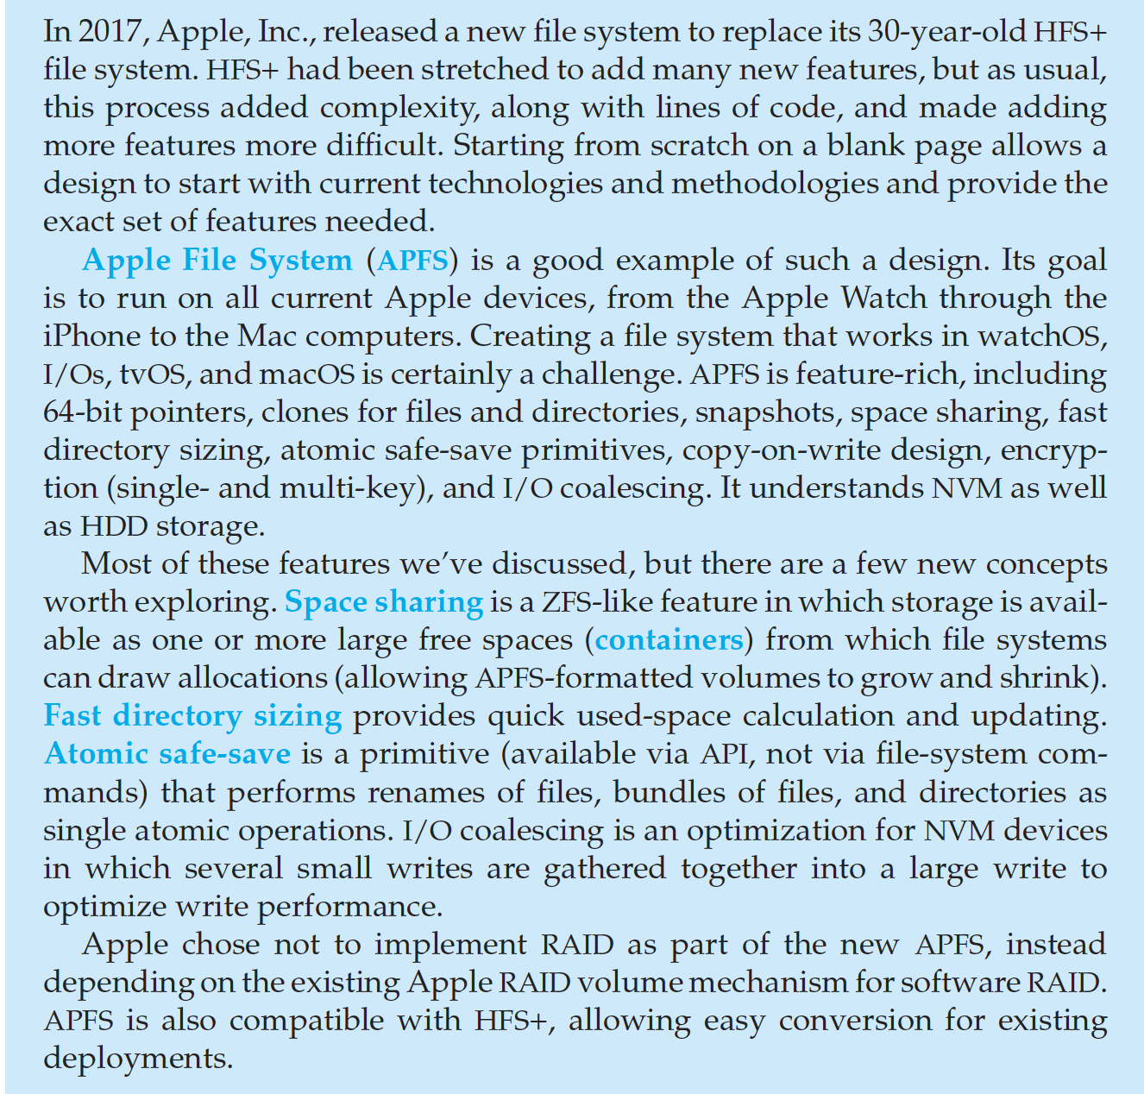
The Apple File System

Slide 94
End of Chapter 14

Slide 95
Chapter 15: File System Internals

Slide 96
Outline
File Systems
File-System Mounting
Partitions and Mounting
File Sharing
Virtual File Systems
Remote File Systems
Consistency Semantics
NFS

Slide 97
Objectives
Delve into the details of file systems and their implementation
Explore booting and file sharing
Describe remote file systems, using NFS as an example

Slide 98
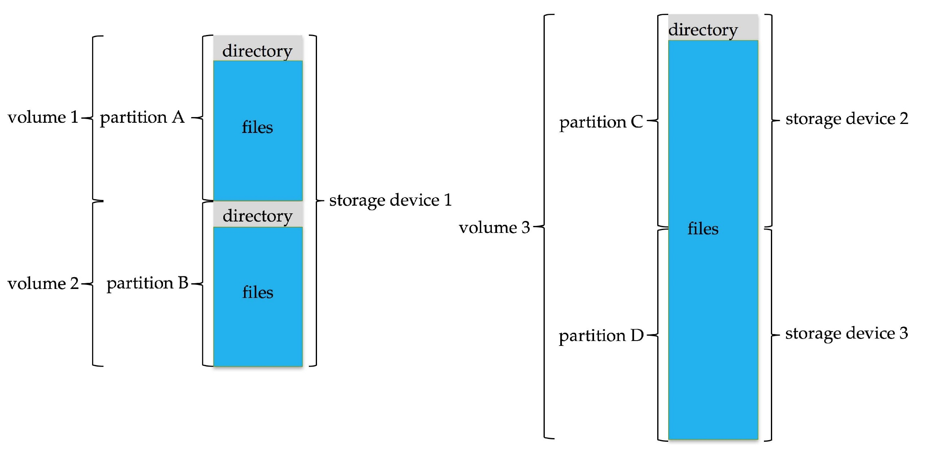
File System
General-purpose computers can have multiple storage devices
Devices can be sliced into partitions, which hold volumes
Volumes can span multiple partitions
Each volume usually formatted into a file system
# of file systems varies, typically dozens available to choose from Typical storage device organization:

Slide 99
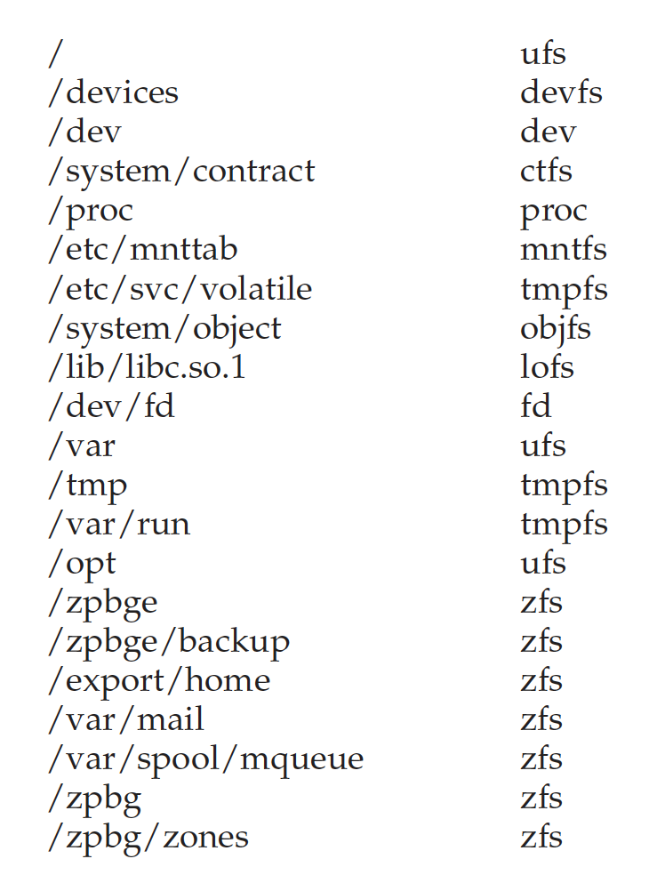
Example Mount Points and File Systems - Solaris

Slide 100
Partitions and Mounting
Partition can be a volume containing a file system (“cooked”) or raw – just a sequence of blocks with no file system
Boot block can point to boot volume or boot loader set of blocks that contain enough code to know how to load the kernel from the file system
Or a boot management program for multi-os booting
Root partition contains the OS, other partitions can hold other OSes, other file systems, or be raw
Mounted at boot time
Other partitions can mount automatically or manually on mount points – location at which they can be accessed
At mount time, file system consistency checked
Is all metadata correct?
If not, fix it, try again
If yes, add to mount table, allow access

Slide 101
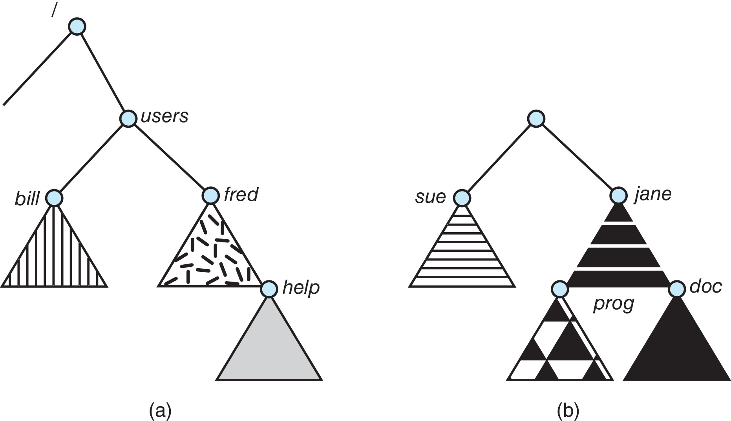
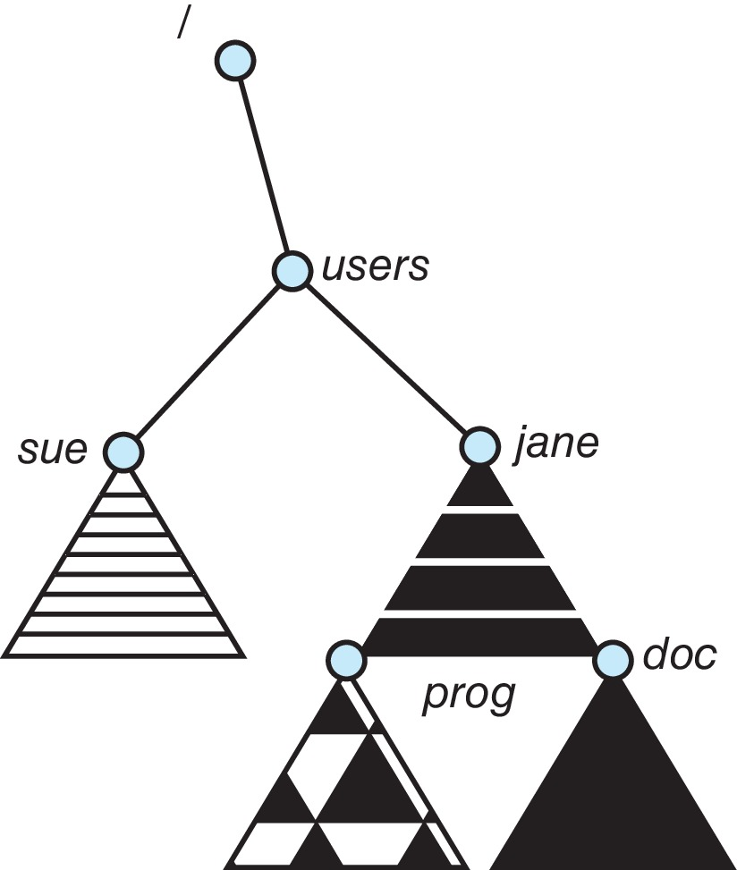
File Systems and Mounting
Unix-like file system directory tree
Unmounted file system
After mounting (b) into the existing directory tree

Slide 102
File Sharing
Allows multiple users / systems access to the same files
Permissions / protection must be implement and accurate
Most systems provide concepts of owner, group member
Must have a way to apply these between systems

Slide 103
Virtual File Systems
Virtual File Systems (VFS) on Unix provide an object-oriented way of implementing file systems
VFS allows the same system call interface (the API) to be used for different types of file systems
Separates file-system generic operations from implementation details
Implementation can be one of many file systems types, or network file system
Implements vnodes which hold inodes or network file details
Then dispatches operation to appropriate file system implementation routines

Slide 104
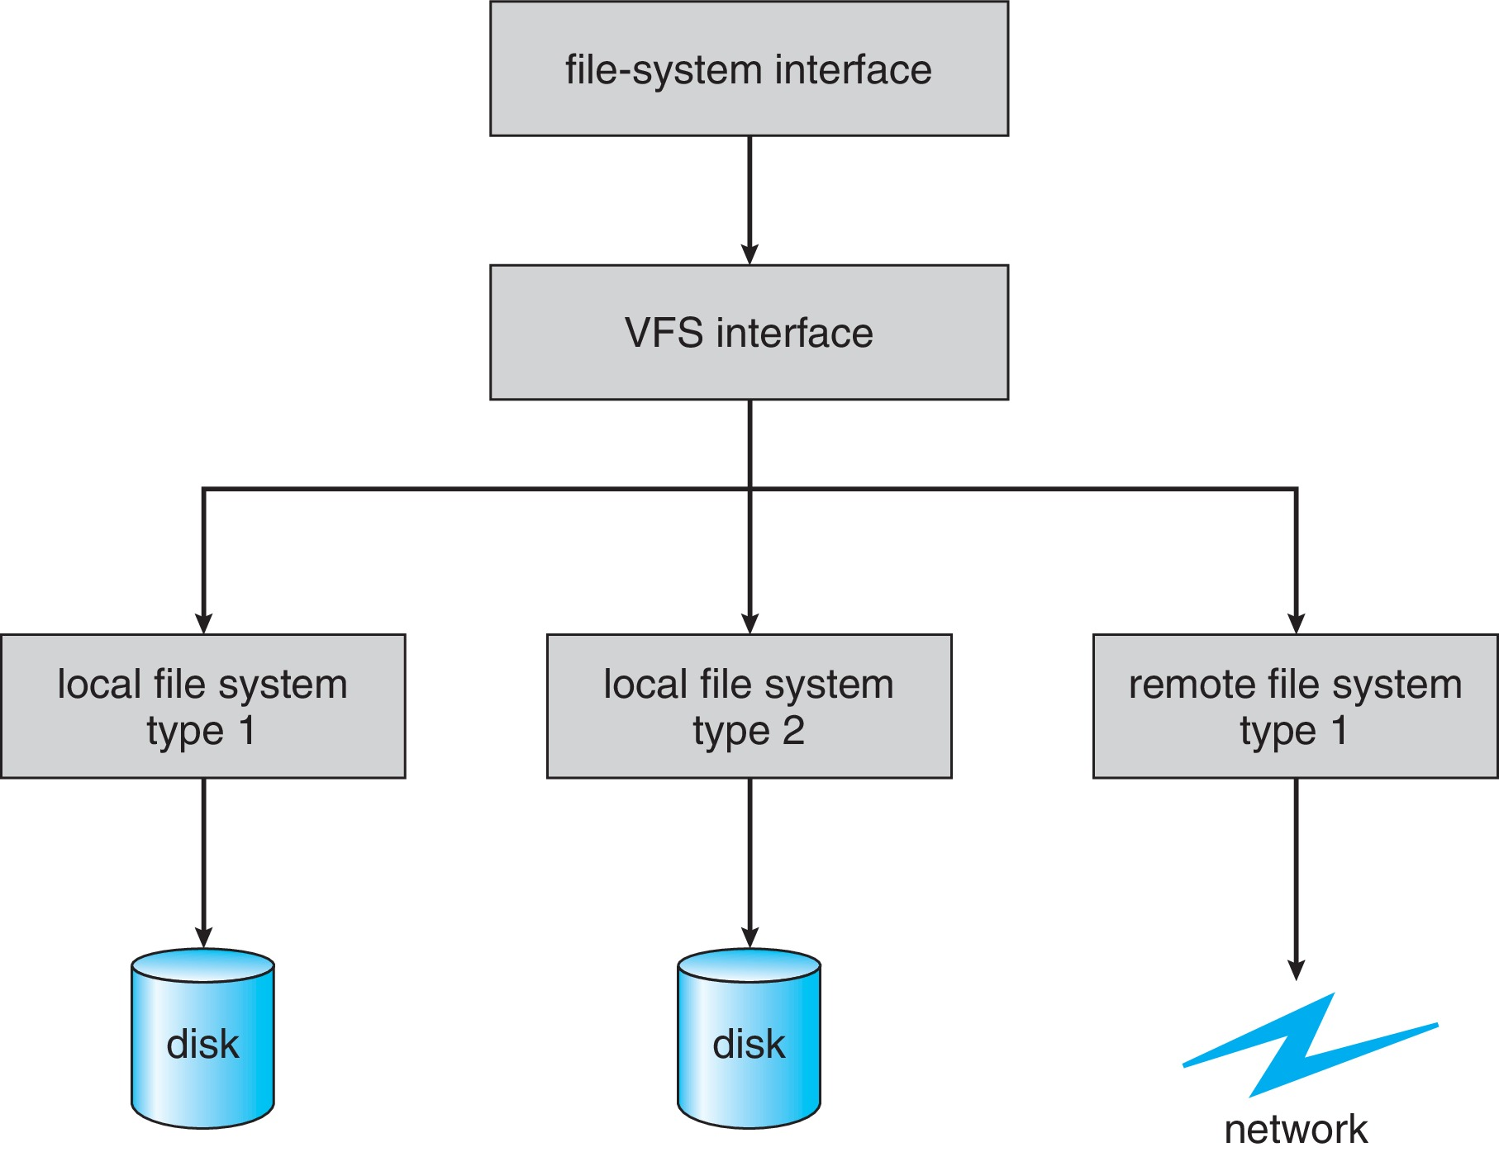
Virtual File Systems (Cont.)
The API is to the VFS interface, rather than any specific type of file system

Slide 105
Virtual File System Implementation
For example, Linux has four object types:
inode, file, superblock, dentry
VFS defines set of operations on the objects that must be implemented
Every object has a pointer to a function table
Function table has addresses of routines to implement that function on that object
For example:
• int open(. . .)—Open a file
• int close(. . .)—Close an already-open file
• ssize t read(. . .)—Read from a file
• ssize t write(. . .)—Write to a file
• int mmap(. . .)—Memory-map a file

Slide 106
Remote File Systems
Sharing of files across a network
First method involved manually sharing each file – programs like ftp
Second method uses a distributed file system (DFS)
Remote directories visible from local machine
Third method – World Wide Web
A bit of a revision to first method
Use browser to locate file/files and download /upload
Anonymous access doesn’t require authentication

Slide 107
Client-Server Model
Sharing between a server (providing access to a file system via a network protocol) and a client (using the protocol to access the remote file system)
Identifying each other via network ID can be spoofed, encryption can be performance expensive
NFS an example
User auth info on clients and servers must match (UserIDs for example)
Remote file system mounted, file operations sent on behalf of user across network to server
Server checks permissions, file handle returned
Handle used for reads and writes until file closed

Slide 108
Distributed Information Systems
Aka distributed naming services, provide unified access to info needed for remote computing
Domain name system (DNS) provides host-name-to-network-address translations for the Internet
Others like network information service (NIS) provide user-name, password, userID, group information
Microsoft’s common Internet file system (CIFS) network info used with user auth to create network logins that server uses to allow to deny access
Active directory distributed naming service
Kerberos-derived network authentication protocol
Industry moving toward lightweight directory-access protocol (LDAP) as secure distributed naming mechanism

Slide 109
Consistency Semantics
Important criteria for evaluating file sharing-file systems
Specify how multiple users are to access shared file simultaneously
When modifications of data will be observed by other users
Directly related to process synchronization algorithms, but atomicity across a network has high overhead (see Andrew File System)
The series of accesses between file open and closed called file session
UNIX semantics
Writes to open file immediately visible to others with file open
One mode of sharing allows users to share pointer to current I/O location in file
Single physical image, accessed exclusively, contention causes process delays
Session semantics (Andrew file system (OpenAFS))
Writes to open file not visible during session, only at close
Can be several copies, each changed independently

Slide 110
The Sun Network File System (NFS)
An implementation and a specification of a software system for accessing remote files across LANs (or WANs)
The implementation originally part of SunOS operating system, now industry standard / very common
Can use unreliable datagram protocol (UDP/IP) or TCP/IP, over Ethernet or other network

Slide 111
NFS (Cont.)
Interconnected workstations viewed as a set of independent machines with independent file systems, which allows sharing among these file systems in a transparent manner
A remote directory is mounted over a local file system directory
The mounted directory looks like an integral subtree of the local file system, replacing the subtree descending from the local directory
Specification of the remote directory for the mount operation is nontransparent; the host name of the remote directory has to be provided
Files in the remote directory can then be accessed in a transparent manner
Subject to access-rights accreditation, potentially any file system (or directory within a file system), can be mounted remotely on top of any local directory

Slide 112
NFS (Cont.)
NFS is designed to operate in a heterogeneous environment of different machines, operating systems, and network architectures; the NFS specifications independent of these media
This independence is achieved through the use of RPC primitives built on top of an External Data Representation (XDR) protocol used between two implementation-independent interfaces
The NFS specification distinguishes between the services provided by a mount mechanism and the actual remote-file-access services

Slide 113
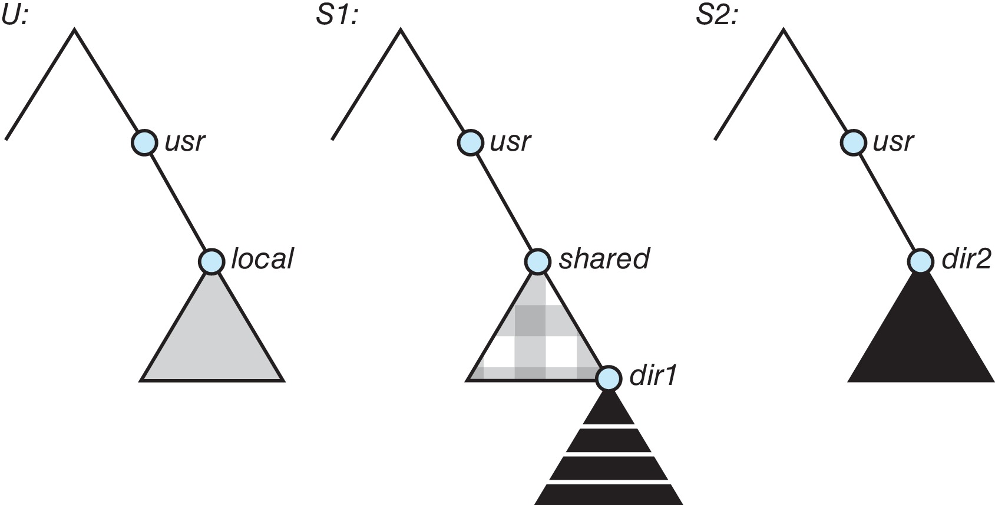
Three Independent File Systems

Slide 114
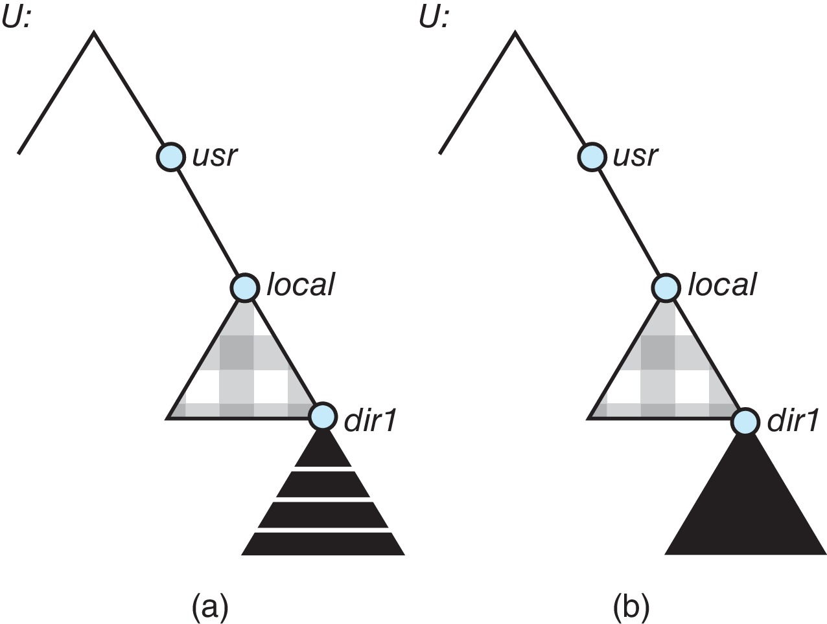
Mounting in NFS
Mounts
Cascading mounts

Slide 115
NFS Mount Protocol
Establishes initial logical connection between server and client
Mount operation includes name of remote directory to be mounted and name of server machine storing it
Mount request is mapped to corresponding RPC and forwarded to mount server running on server machine
Export list – specifies local file systems that server exports for mounting, along with names of machines that are permitted to mount them
Following a mount request that conforms to its export list, the server returns a file handle—a key for further accesses
File handle – a file-system identifier, and an inode number to identify the mounted directory within the exported file system
The mount operation changes only the user’s view and does not affect the server side

Slide 116
NFS Protocol
Provides a set of remote procedure calls for remote file operations. The procedures support the following operations:
searching for a file within a directory
reading a set of directory entries
manipulating links and directories
accessing file attributes
reading and writing files
NFS servers are stateless; each request has to provide a full set of arguments (NFS V4 is newer, less used – very different, stateful)
Modified data must be committed to the server’s disk before results are returned to the client (lose advantages of caching)
The NFS protocol does not provide concurrency-control mechanisms

Slide 117
Three Major Layers of NFS Architecture
UNIX file-system interface (based on the open, read, write, and close calls, and file descriptors)
Virtual File System (VFS) layer – distinguishes local files from remote ones, and local files are further distinguished according to their file-system types
The VFS activates file-system-specific operations to handle local requests according to their file-system types
Calls the NFS protocol procedures for remote requests
NFS service layer – bottom layer of the architecture
Implements the NFS protocol

Slide 118
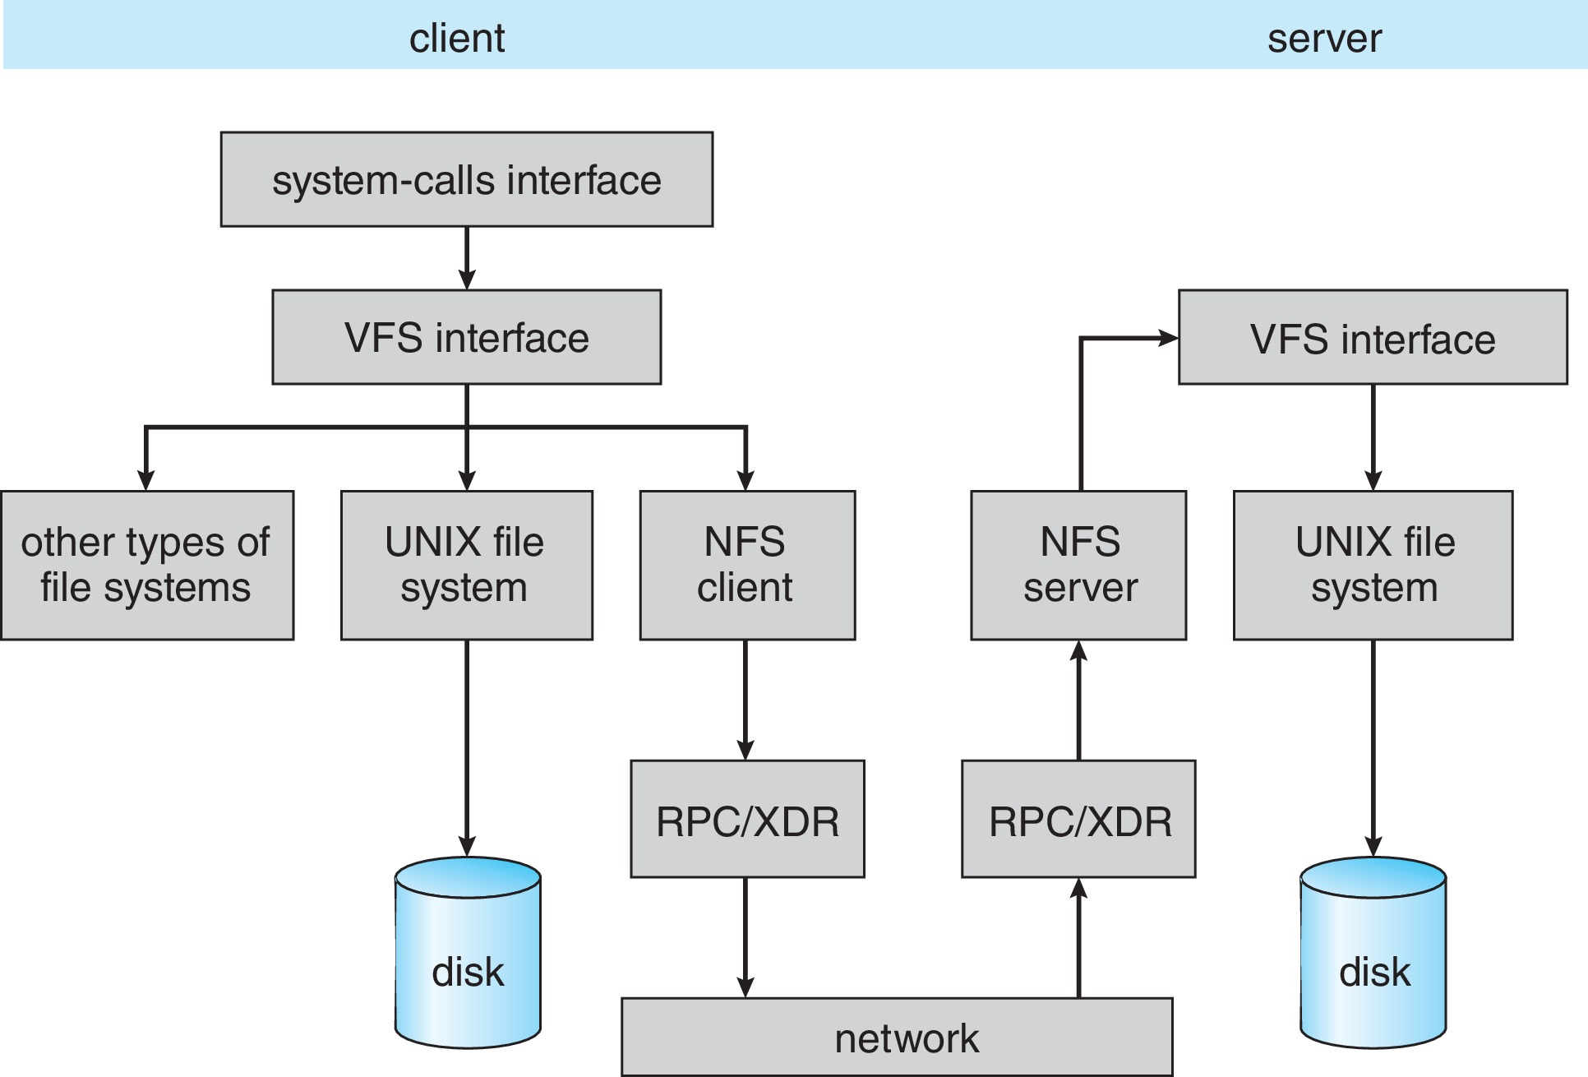
Schematic View of NFS Architecture

Slide 119
NFS Path-Name Translation
Performed by breaking the path into component names and performing a separate NFS lookup call for every pair of component name and directory vnode
To make lookup faster, a directory name lookup cache on the client’s side holds the vnodes for remote directory names

Slide 120
NFS Remote Operations
Nearly one-to-one correspondence between regular UNIX system calls and the NFS protocol RPCs (except opening and closing files)
NFS adheres to the remote-service paradigm, but employs buffering and caching techniques for the sake of performance
File-blocks cache – when a file is opened, the kernel checks with the remote server whether to fetch or revalidate the cached attributes
Cached file blocks are used only if the corresponding cached attributes are up to date
File-attribute cache – the attribute cache is updated whenever new attributes arrive from the server
Clients do not free delayed-write blocks until the server confirms that the data have been written to disk

Slide 121
End of Chapter 15

